Slide 1

Predicting Credit card Churners
Team Members
Nikitha Rao
Pratibha Kumari
Akshara Motati
Venkata Pathuri

Slide 2
Agenda
Project Description
Data Preprocessing
Data Description
Data Exploration
Predictive Modelling
Results
Conclusion

Slide 3
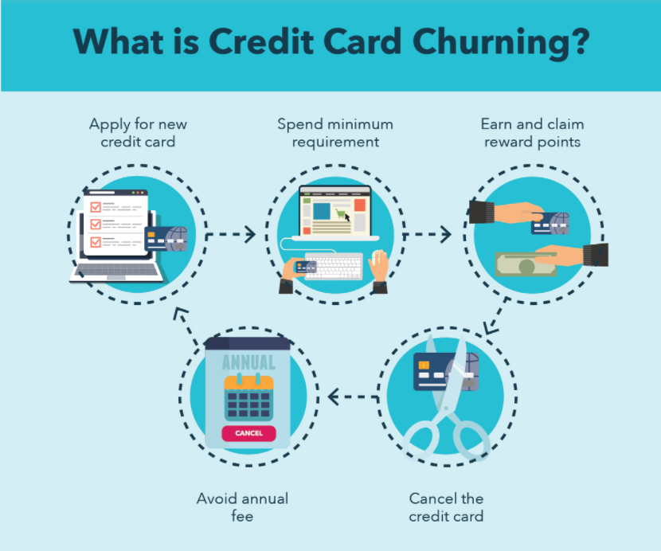
Project Description
Churn is a measure of the proportion of accounts which cancel or choose not to renew their subscriptions.
For businesses such as credit card companies, customer churn is one of the most significant and daunting issue.
Company wants to know the reason behind customer churn and would like to focus on people leaving or cancelling their credit card services.
The objective of this project is to use historical customers data to predict customers who will get churned so that company could provide better services and change decisions of the customers.

Slide 4
Project Description(cont.)
Dataset contains 10128 observations of 23 variables.
It contains demographic information of customers along with the credit details. Each row represents a customer with respective credit information.
Dataset source: https://www.kaggle.com/sakshigoyal7/credit-card-customers

Slide 5
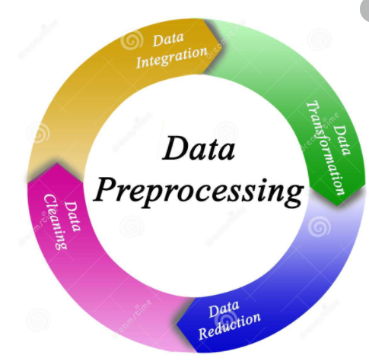
Data Preprocessing
We imported our dataset ‘BankChurners’ in R which has 23 variables and 10127 observations.
Column named “Client num” was removed because it has no significance with our analysis.
Next, we looked for missing value in our dataset and found that we didn’t have any. Therefore, we didn’t perform any imputations.
We further removed values which said “Unknown” to have a cleaner dataset for our analysis.
We factored the required categorical variables like Gender, Attrition Flag, Marital Status, Education level, Card Category and income category and added numerical labels for easiness of analysis.
Final step, we filtered the dataset to have random 4000 observations which is our final dataset.

Slide 6

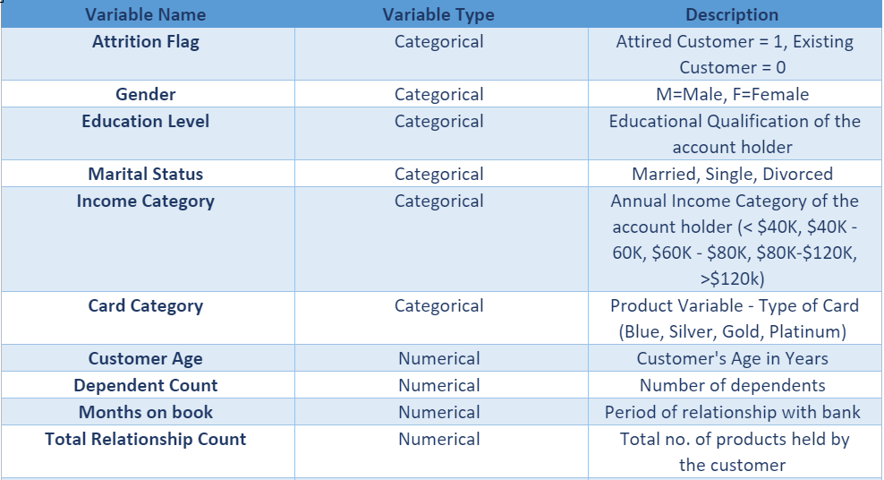
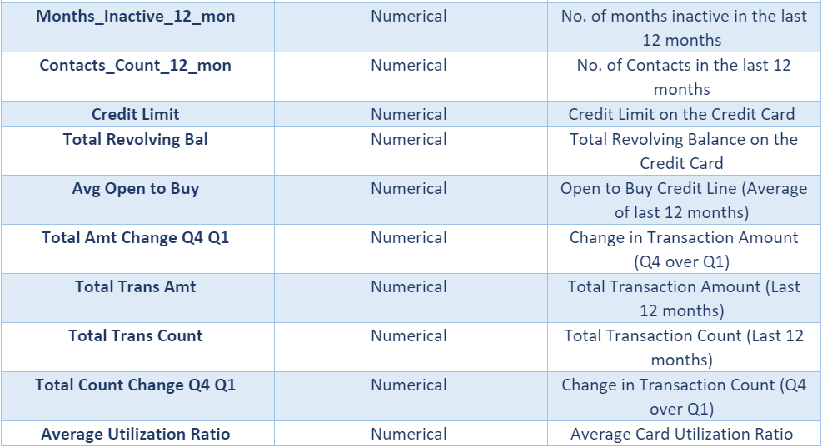
Data Description

Slide 7
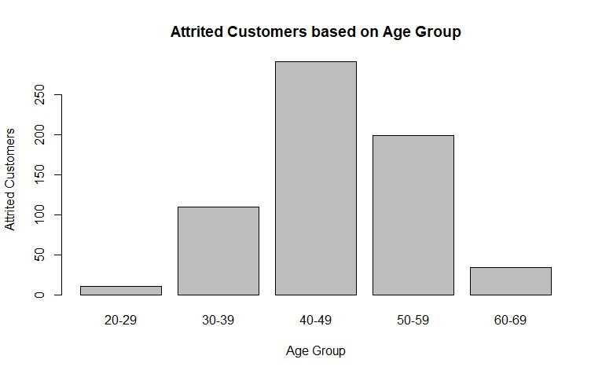
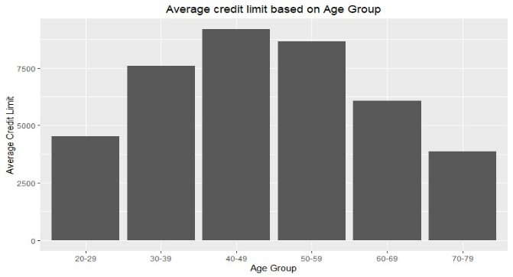
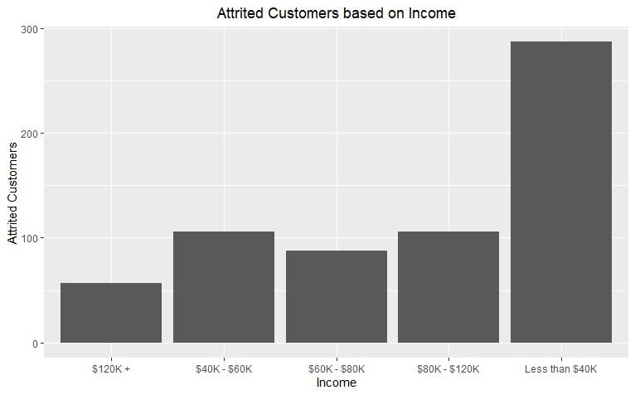
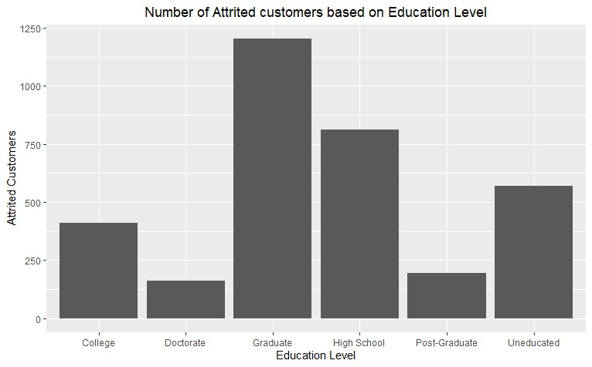
Data Exploration

Slide 8
Data Exploration Findings:
:
Most attritted customers had comparably a very high credit limit on their cards and fell into age group which was above average.
Attritted customers were also noted to have extremely low transacted amount in last 12 months.
The total number of products owned by attritted customers was found to be the lowest.
Attritted customers had limited number of contacts with the bank in the last 12 months.
Average card utilization ratio was also excessively high for attritted customers.

Slide 9

Model Building-Predictive Modelling
We have built 4 different classification models.
Random Forest
Decision Tree
Naïve Bayes
Logistic Regression
The results from these models are divided into 2 different parts
1- Customers who did not churn
0- Customers who churned
To ensure overfitting was reduced we applied tenfold cross validation approach.
For each model’s performance evaluation, we utilized different metrics like Precision, Recall, Area under the curve, overall accuracy, and F measure.
Since finding the customer who would churn is the aim, we reviewed the metrics to find the model with the highest precision. The rationale behind this the importance to correctly predicting the customer who would churn.

Slide 10
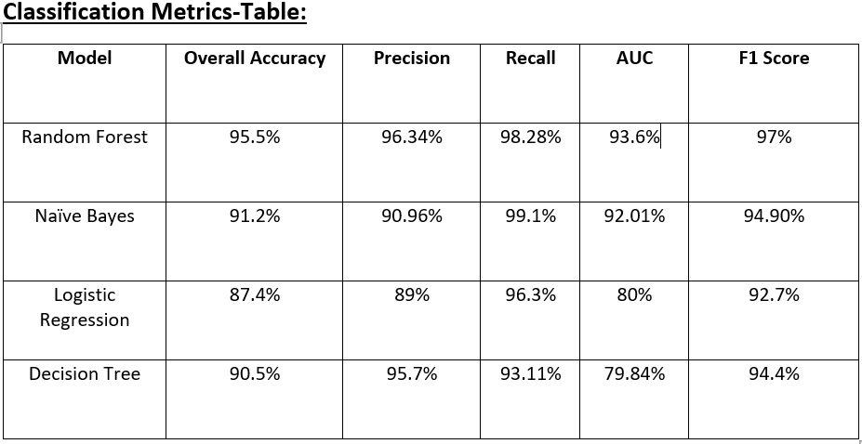
Results

Slide 11
Conclusion and Implications
The above analysis was made on the dataset that’s pulled from Kaggle to predict credit card churning customers.
The original dataset consisted of 10128 records. The dataset was reduced to 4000 random samples to perform the predictive analysis.
As part of the data cleaning process, unnecessary columns and missing values were deleted. Also, added factored column and converted few existing columns values to factored columns values.
Understanding the data plays a crucial role in analyzing the factors/variables associated to attrition. This has been achieved by performing data visualization and exploration.
Among all the models built, Random Forest performed better than the others.
The important variables picked by the model in predicting the customers were total transactional amount, total relationship count, total transactional count, total revolving balance, and total change in transaction count.

Slide 12
Conclusion and Implications (cont..)
As per the analysis done, total transactional amount and total revolving balance factors should be taken into consideration before deciding the attrition of the customer.
It is recommended to choose a predictive model that has a higher precision value.
Varied number of predictive models should be built before deciding if the customer might get churned or not in order to identify him/her accurately.
By correctly identifying the customers who might get churned, companies can provide better services in order to retain them.

Slide 13

THANK YOU

